Slide 1

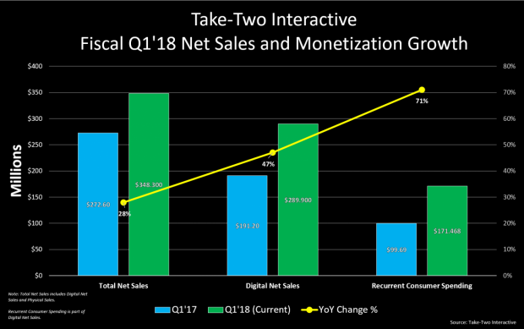
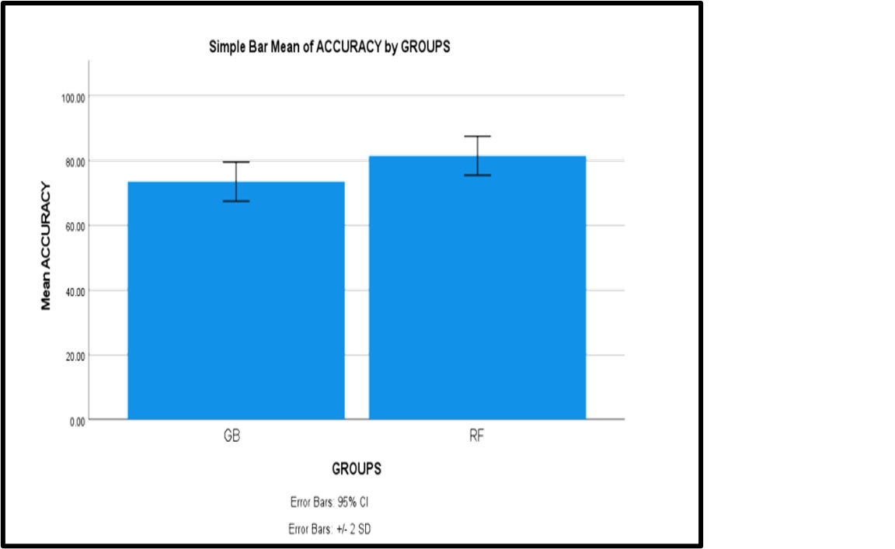
Name: Mr. Jonnalagadda Sai Chandu Register Number: 192211216
Guided by K.V. Kanimozhi
Ms. Poorani.S
Guided by Dr. Mary Valantina. G
Prediction of Sales in Video Games using Random Forest Algorithm in Comparison with Gradient Boosting Algorithm to Improve Accuracy
INTRODUCTION
This research aims to enhance the accuracy of sales predictions in the video game industry by comparing two powerful algorithms: the Random Forest Algorithm and the Gradient Boosting Algorithm
In the video game industry, the problem is the lack of precise sales forecasts in most competitive video gaming industry
The machine learning algorithm like RF and GB will give exact sales predictions in the video gaming industry
Predicting sales in video games is crucial for strategic planning, marketing decisions, and resource allocation within the gaming industry
Random Forest Algorithm is an ensemble learning technique that constructs multiple decision trees during training and outputs the mode of the classes or mean prediction of the individual trees
Gradient Boosting is a machine learning technique used for building predictive models, particularly decision trees, in a sequential manner.
Fig.1 Video games sales prediction
MATERIALS AND METHODS
Sample Size: 20
Group-1 (Random Forest): 10 samples
Group-2 (Gradient Boosting): 10 samples
The samples are tested in SPSS statistical analysis and outputs have been derived
The statistical features extracted are count of samples, mean, standard deviation, minimum and maximum
Non-number data is converted into numerical data for comparison between two algorithms in the dataset
Data Collection
Data
Pre-processing
Splitting data into training data and testing data
Models training (Random Forest & Gradient Boosting )
Performance comparison of Random Forest with Gradient Boosting for video games sales
Models validation
Fig.2 Flow chart of Video game Sales Prediction for RF algorithm in comparison with GB algorithm
RESULTS
Table.1 Group Statistics of Random Forest and Gradient Boosting Algorithms which contains mean, standard deviation and standard deviation error
Groups |  | N | Mean | Standard deviation | Standard deviation error
Accuracy rate | RF | 10 | 86.40 | 3.027 | 0.954
 | GB | 10 | 78.75 | 3.027 | 0.957
In the present work, Random Forest Algorithm is compared with GB algorithm and it depicts that the proposed algorithm gives more accuracy than GB
The Random Forest model attained 86.40% accuracy, on the other hand Gradient Boosting Algorithm attained an accuracy of 78.75%
Fig.3 Mean Accuracy Analysis (GB Vs RF)
DISCUSSION AND CONCLUSION
Based on t-test statistical analysis, the significance value of p=0.001 (independent sample t - test p<0.05) is obtained and shows that there is a statistical significant difference between the GB and RF. The average accuracy values of two Algorithms: Random Forest Algorithm - 86.40% Gradient Boosting – 78.75%
From the work , it is concluded that the Random Forest algorithm attains the high accuracy when comparing with other Machine Learning Algorithms in video games sales Prediction. Moving forward, researchers could delve deeper into optimizing hyperparameters and feature engineering to further enhance predictive accuracy
Additionally, exploring the integration of alternative data sources such as user behavior analytics and sentiment analysis from social media platforms could provide valuable insights for improving sales forecasts in the video game industry
Furthermore, investigating the scalability and computational efficiency of these algorithms for large-scale datasets could broaden their applicability in real-world scenarios. In conclusion, the comparison between Random Forest and Gradient Boosting algorithms highlights their effectiveness in refining sales predictions within the video game industry
BIBLIOGRAPHY
Edwards, Caitlyn G., Catherine C. Pollack, Sara J. Pritschet, Keally Haushalter, John W. Long, and Travis D. Masterson. 2022. “Prevalence and Comparisons of Alcohol, Candy, Energy Drink, Snack, Soda, and Restaurant Brand and Product Marketing on Twitch, Facebook Gaming and YouTube Gaming.” Public Health Nutrition 25 (1). DOI: 10.1109/MPOT.2011.941083
Etchells, Peter J., Alexandra L. Morgan, and Daniel S. Quintana. 2022. “Loot Box Spending Is Associated with Problem Gambling but Not Mental Wellbeing.” Royal Society Open Science 9 (8): 220111. DOI: 10.1109/CSIE.2009.1001
Gard, Elizabeth Townsend, and W. Ronald Gard. 2021. Video Games and the Law. Routledge. DOI: 10.1109/CIG.2018.8490456
Islam, Md Irteja, Raaj Kishore Biswas, and Rasheda Khanam. 2023. “Effect of Internet Use and Electronic Game-Play on Academic Performance of Australian Children.” Scientific Reports 10 (1): 21727. DOI:10.1109/ISKE54062.2021.9755343
Hansch, Ronny. 2024. Handbook of Random Forests: Theory and Applications for Remote Sensing. World Scientific Publishing Company. DOI: 10.1098/rsos.220111

